Slide 1
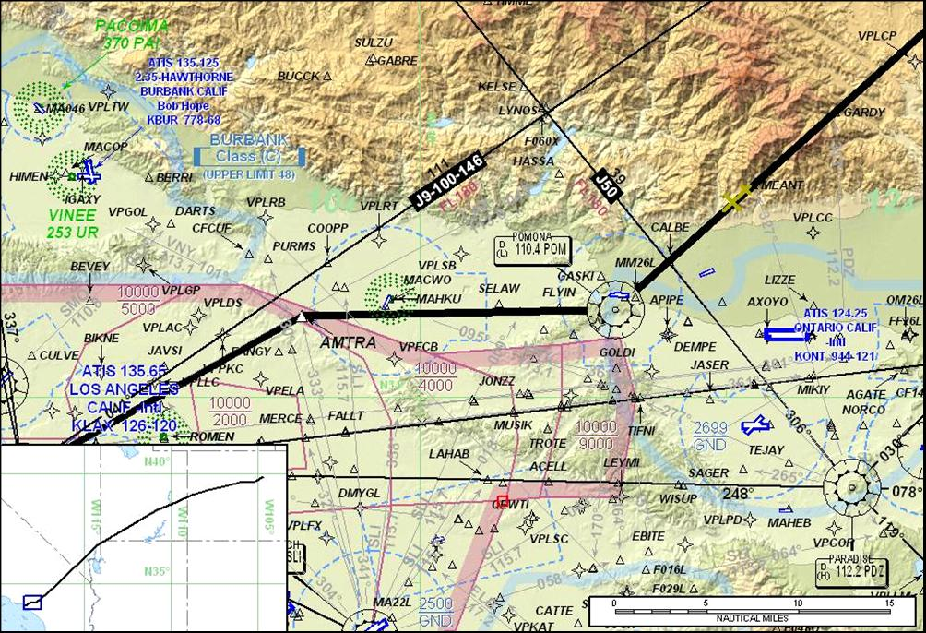
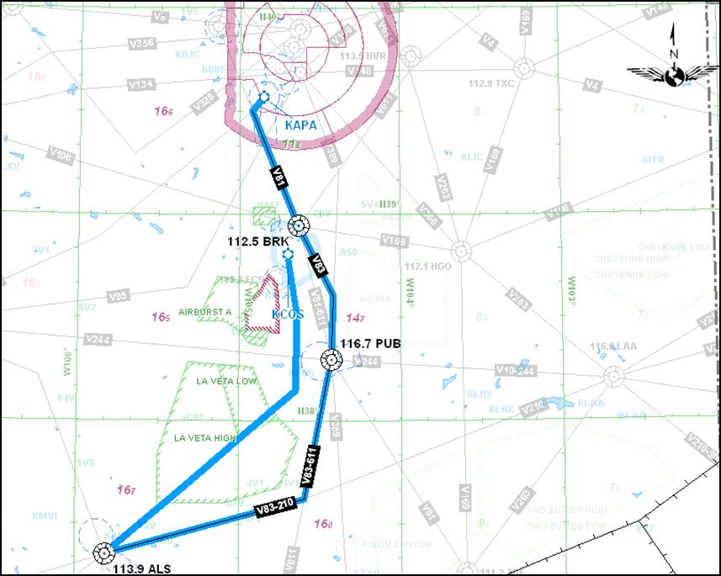
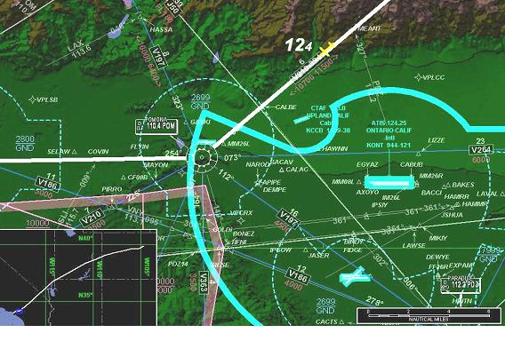
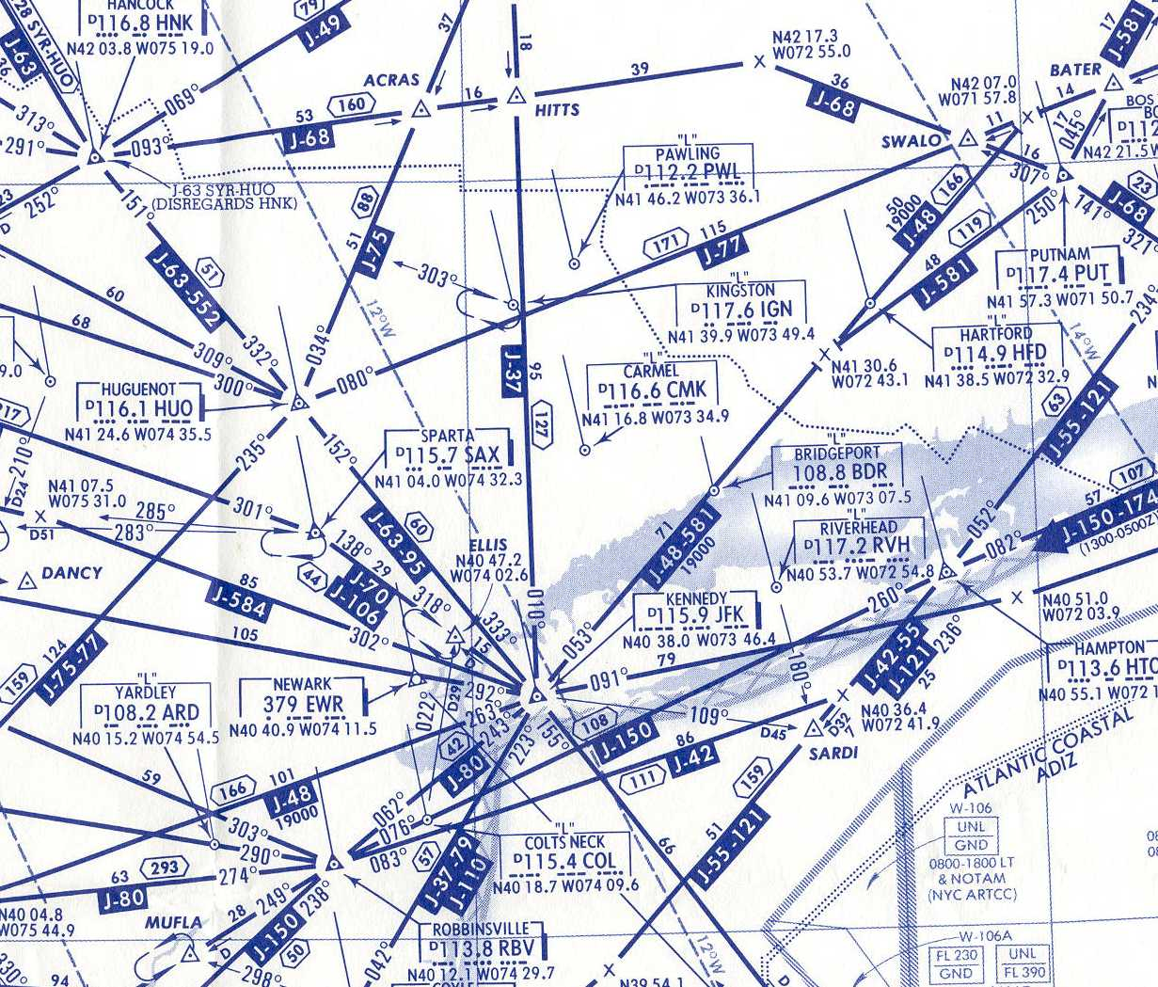
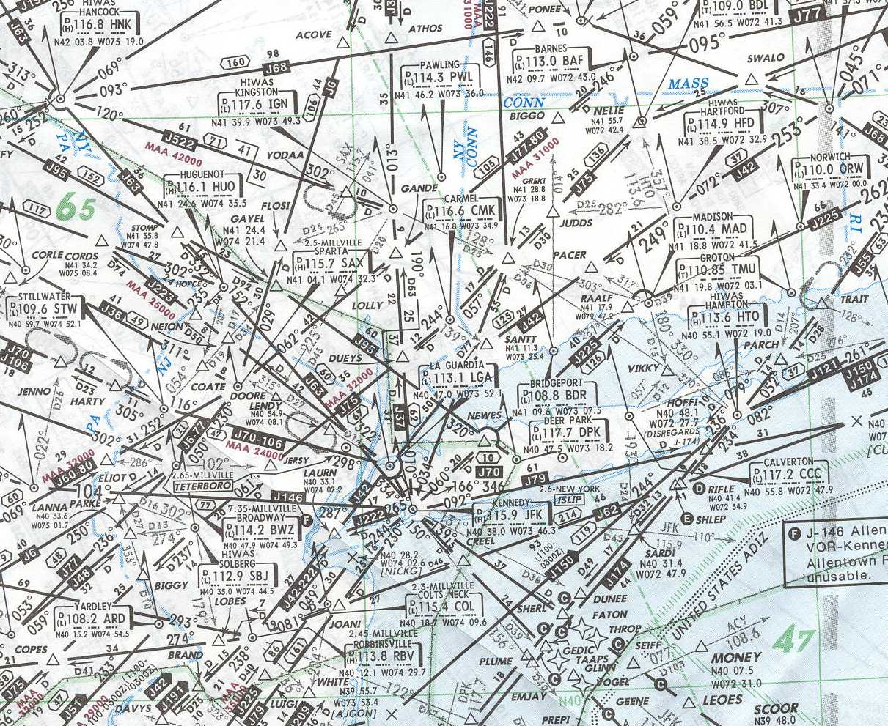
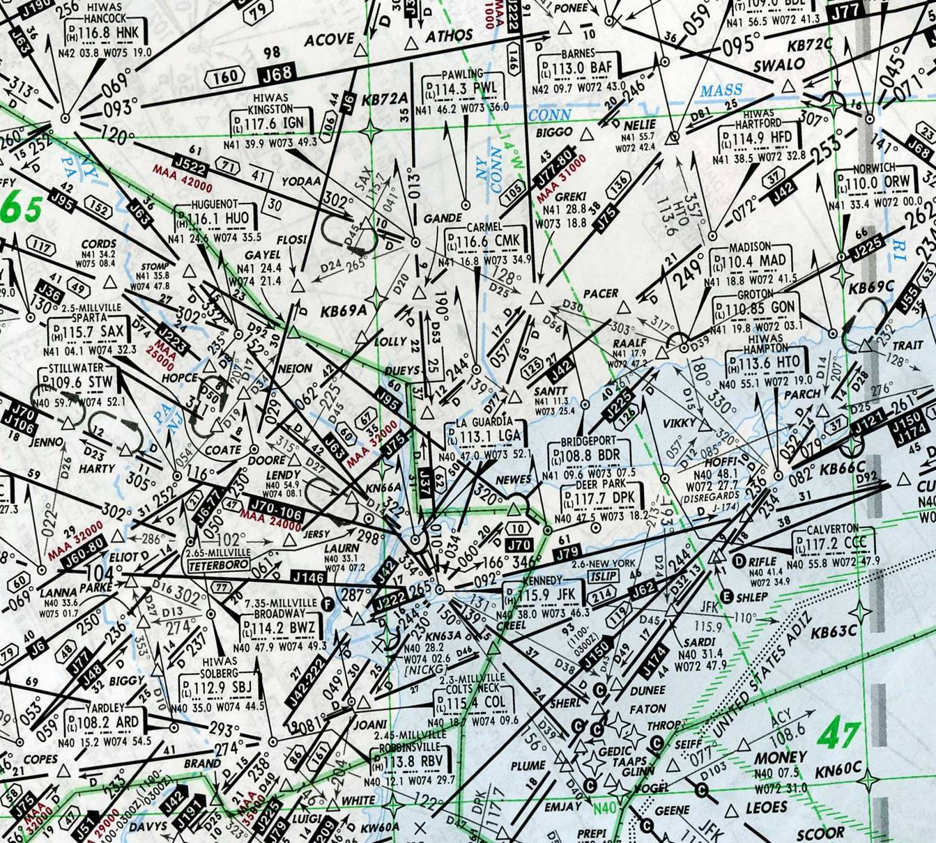
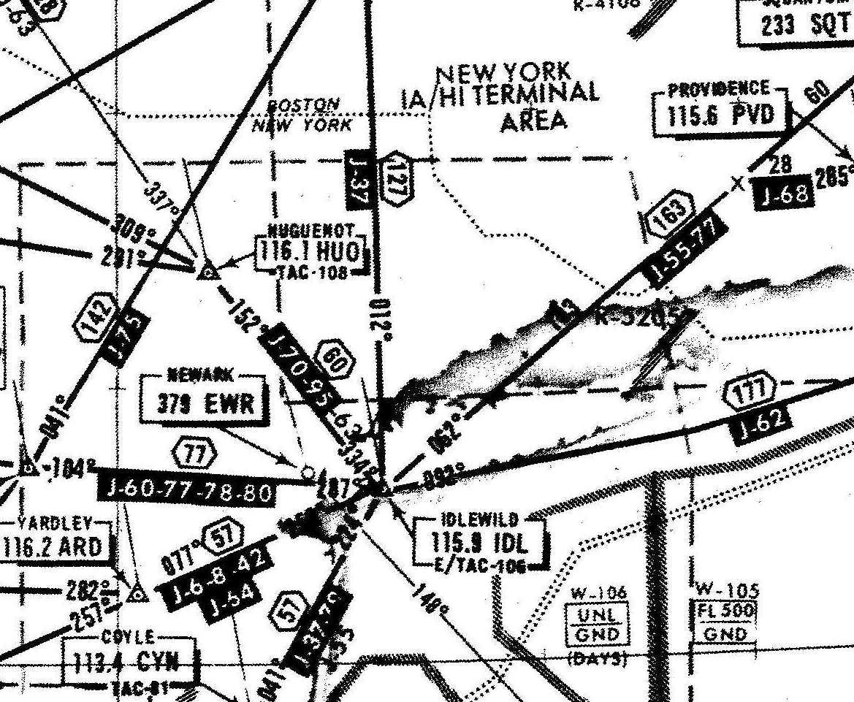
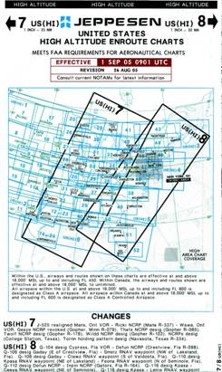
Digital Transformation
2006
1962
1977
2002
2010
Digital

Slide 2
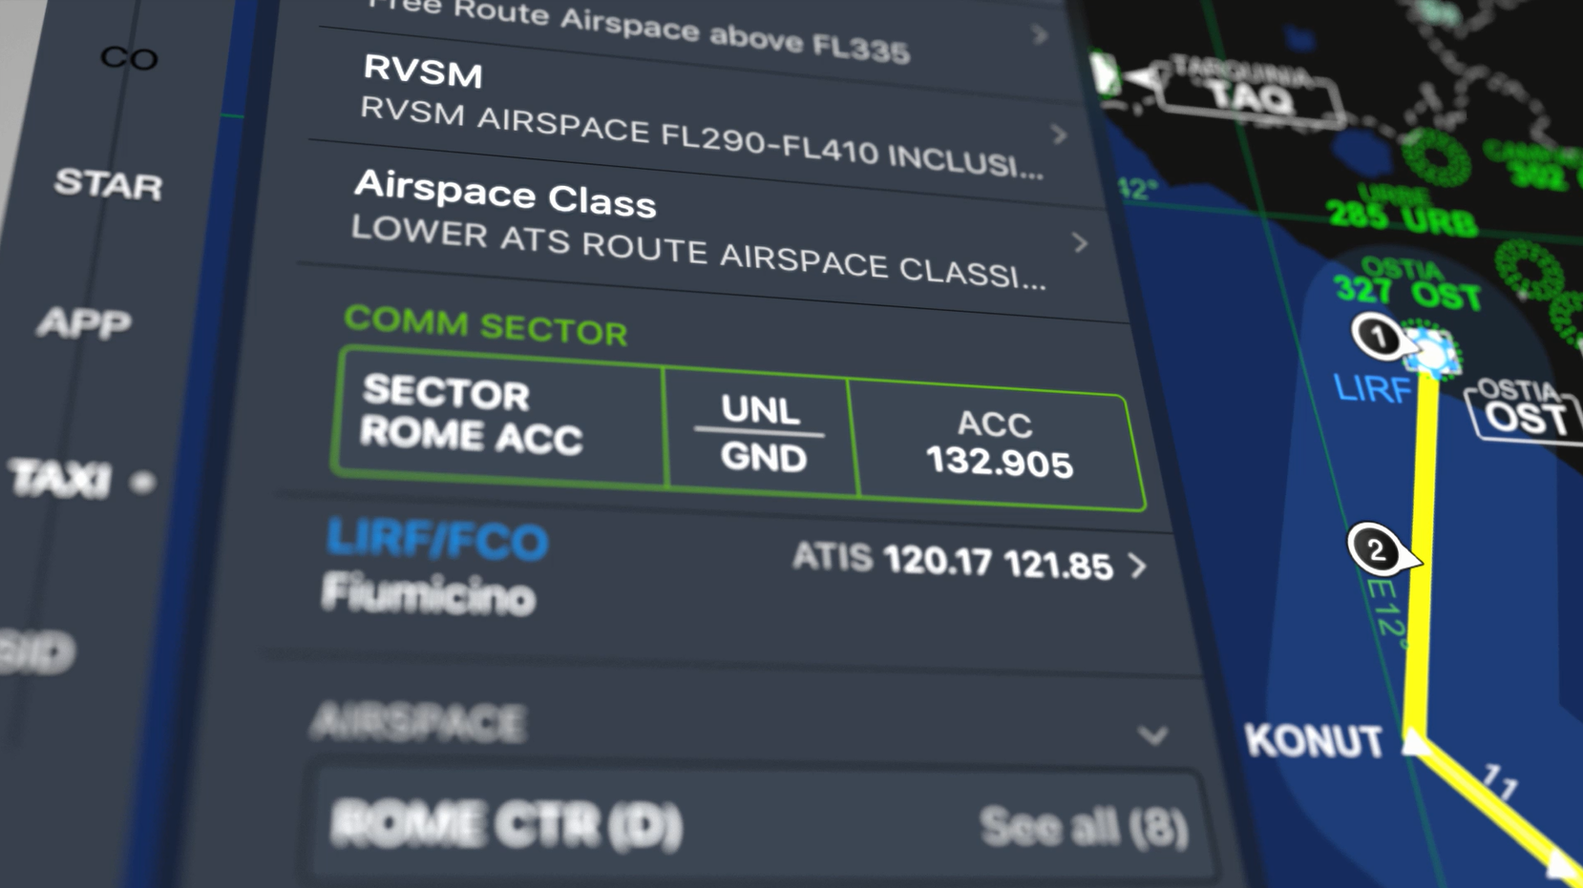
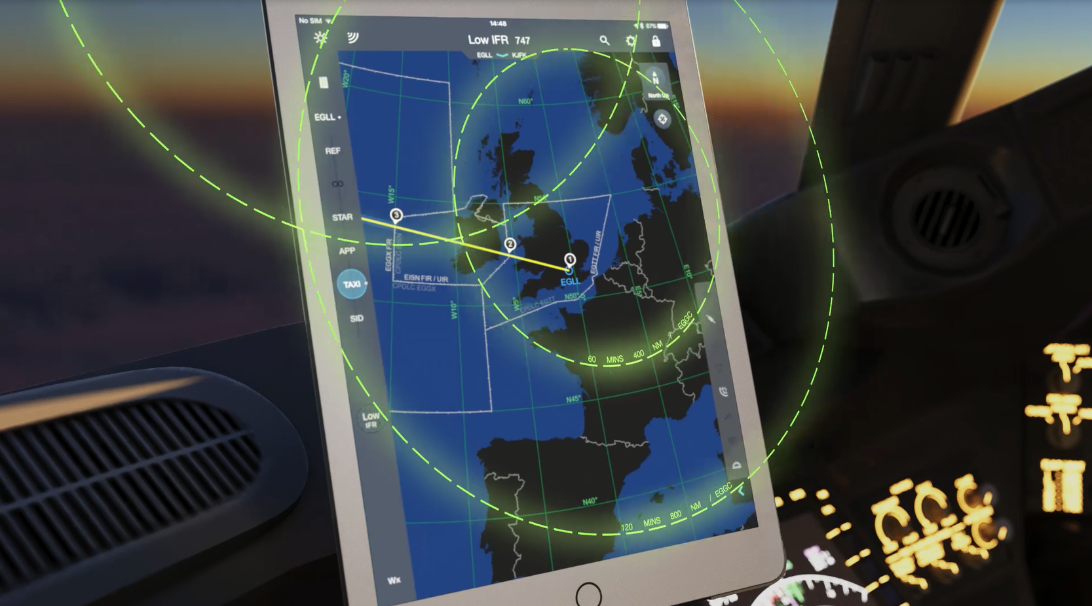
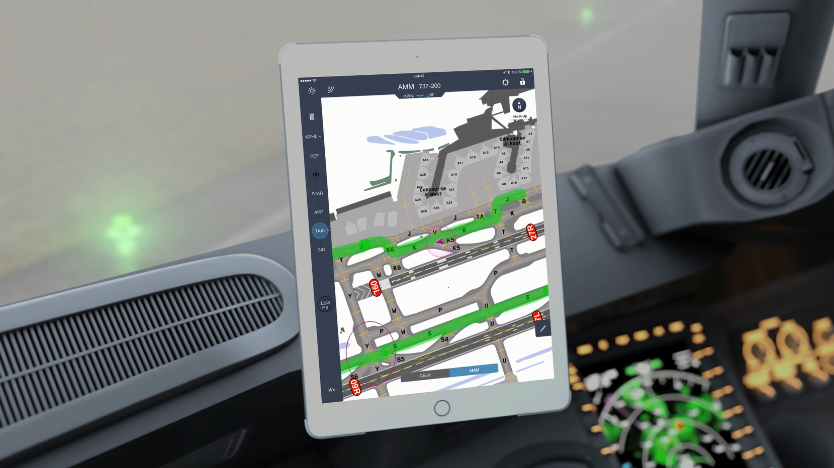
New Enhancements
SmartNotes
information pilots require when and where they need it. Analyzing chronological and geospatial data, it intelligently keeps pilots informed throughout their flight while minimizing interaction with their mobile EFB device
Tailored Enroute
Integrate company specific data
Airport Moving Maps improves pilot situational awareness at large or unfamiliar airports through ownship depiction on dynamically rendered terminal charts to increase runways safety, particularly during times of high congestion or poor visibility conditions.

